Slide 1
Gradebook App
Storyboard / Initial Design

Slide 2
Navigation Elements
The left justified nav will be available in each view
Clicking one of the terms will bring up the "Term" view for the selected semester
Clicking a class will bring up the "Class" view for the selected term
Clicking the "Change" button under grading scale will change the grade scale for the active class
The grade scale will include a letter grade option. The letter will correspond to a number (0-4) that can be used to determine an average
The nav elements at the top display the current view - from left to right: User, Term, Class, Assignment or Student

Slide 3
Logging in
This application will include a login page, most likely a modal, which will not be covered in this document.
Upon successful login, the user will be greeted with a view summarizing the current semester. The view will default to the current semester as determined by date, and the user will have the option to change semester from the welcome screen.
The default view will include a brief summary of classes for the current semester including number of students, grade average breakdown (by letter), number of students, and most recent assignment
Each view will include graphs in a right justified div displaying total number of students and grade breakdown for all current term classes

Slide 4
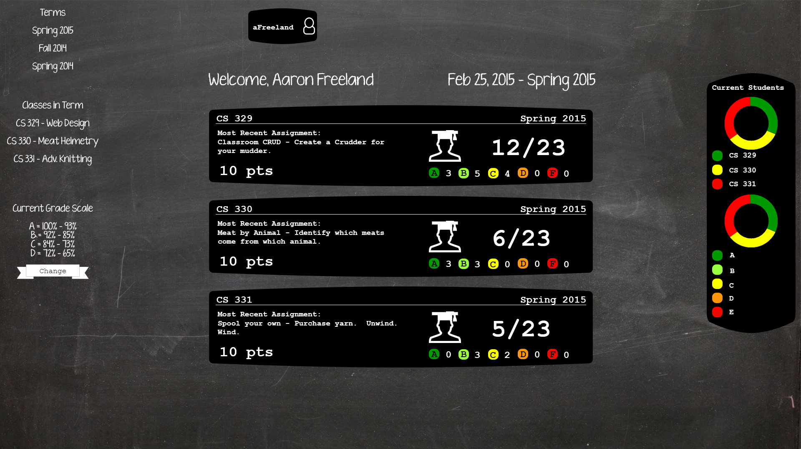

Slide 5
Class View
The Class view will append a class identifier to the top nav
The percentage in the top left of the class view reflects the overall average of all students and grades in the class
The rows of the entry form represent students and the columns represent assignments. Assignments can also be added from the class view
The far right row of each student row will contain the student's current average, which will be color coded according to their current letter grade

Slide 6
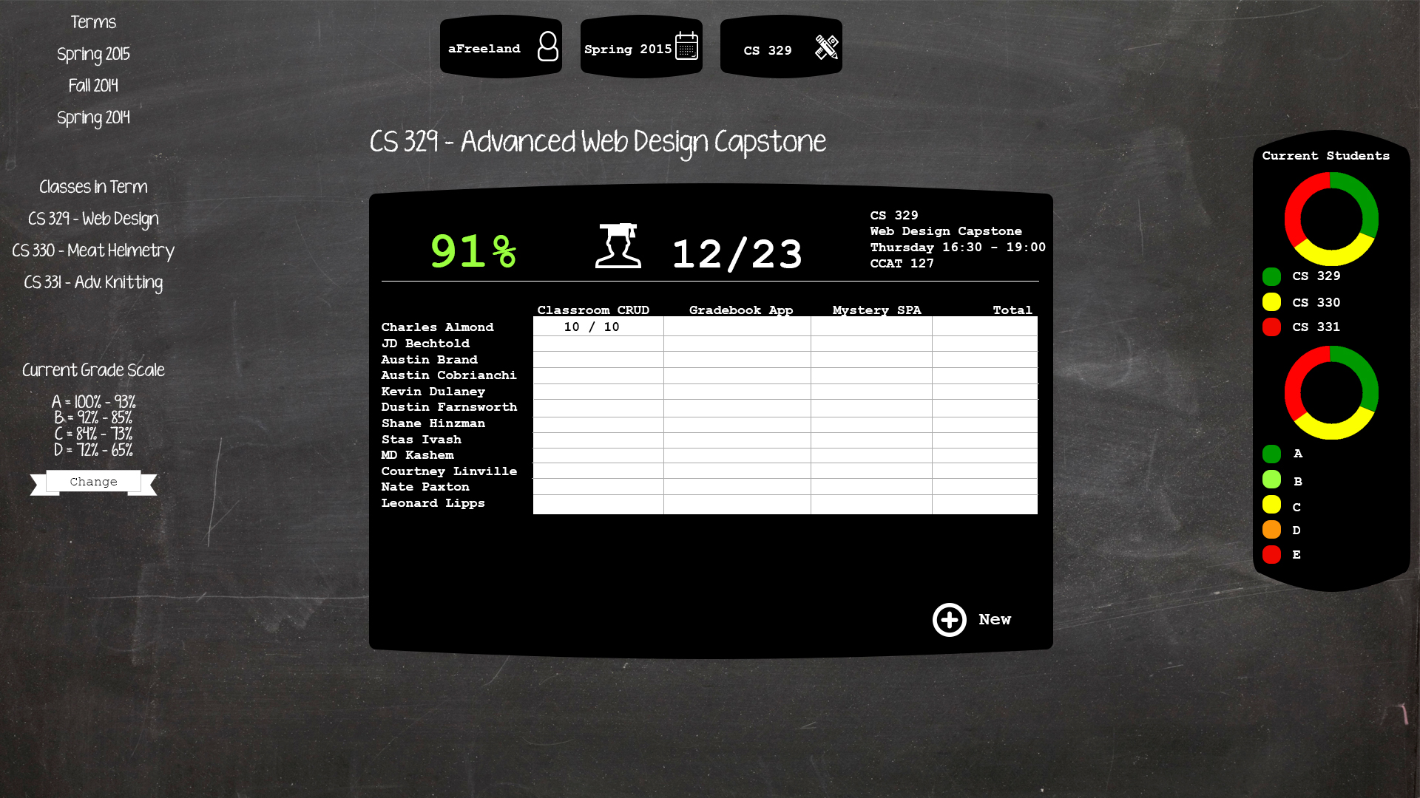

Slide 7
Assignment View
The assignment view will append an assignment to the top nav
Clicking an assignment from the Class view will bring up the Assignment view for the corresponding assignment
The average in the upper is the average of all grades in the class for the assignment
The grades next to each student will be color coded according to the letter grade the student has achieved for the graded assignment
The graph will display a letter grade breakdown

Slide 8
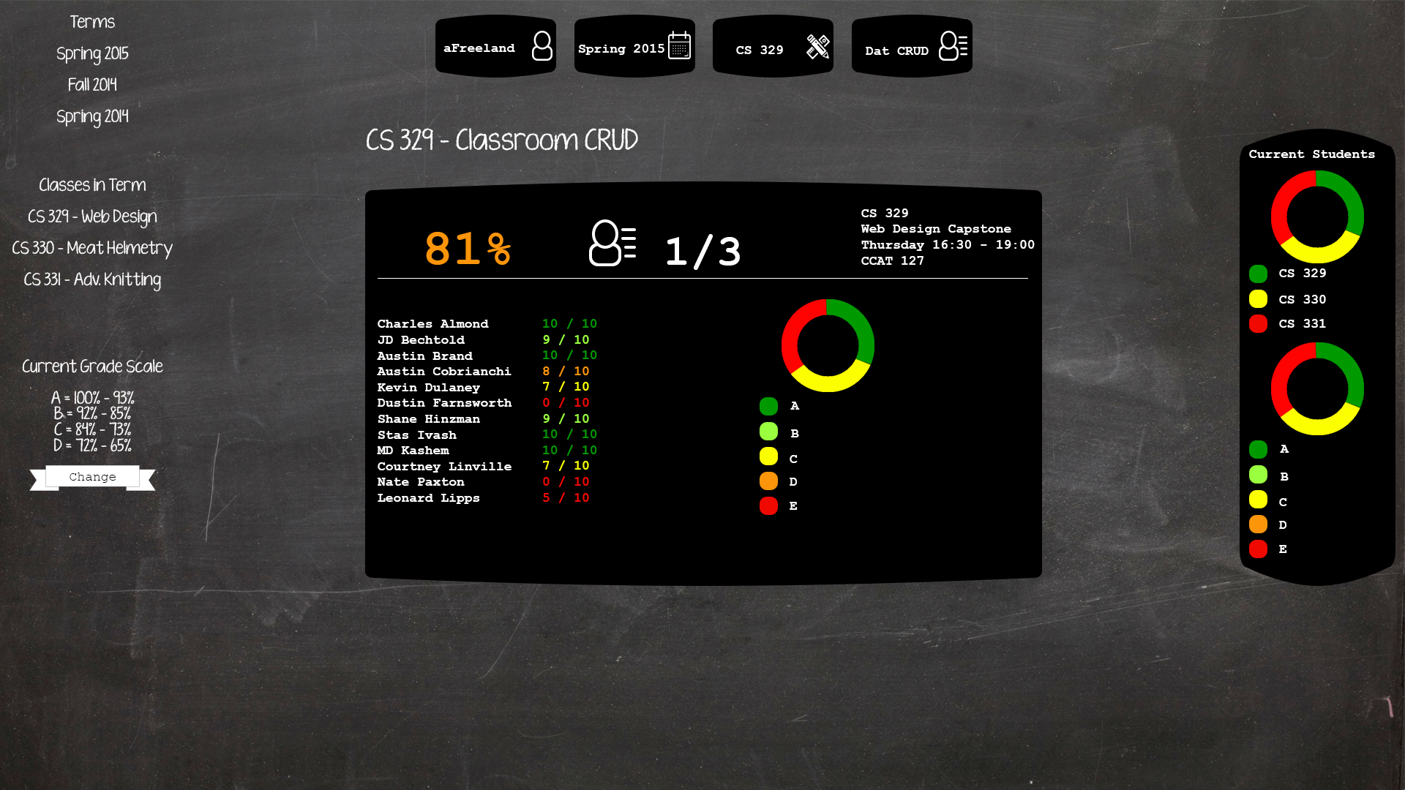

Slide 9
Student View
Clicking a student from the class view will bring up the student view
The average displayed in the top left is the grade the student has in the class from which the student was clicked
If a student belongs to more than one class, the other class grades will be displayed
The graph will display a grade breakdown of each assignment

Slide 10
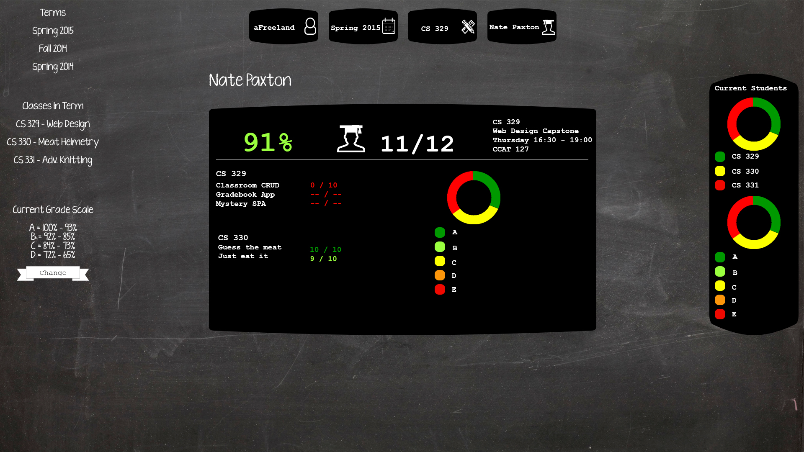

Slide 11
Grade Scale View
The grade scale can be changed from the grade scale view
Javascript will determine which view is active when the change button is pressed and change the scale for only that class or assignment
A letter only grade system can be substituted, and the average will be determined by the point value on a grade point scale

Slide 12
Edit Student View
Students can be edited from the Edit Student view
Multiple classes can be assigned to a single student

Slide 13
Edit Term View
Terms can be edited from the Edit Term View
Multiple classes can be added to a single term

